Slide 1




Methods
Defining and Using Methods, Parameters, Return Values, Overloads
Methods
SoftUni Team
Technical Trainers
Software University
http://softuni.bg

Slide 2

Table of Contents
Using Methods
What is a Method? Why Use Methods?
Declaring and Invoking Methods
Methods with Parameters
Passing Parameters and Returning Values
Method Overloading
Methods: Naming and Best Practices

Slide 3
Questions?
sli.do #fund-softuni

Slide 4
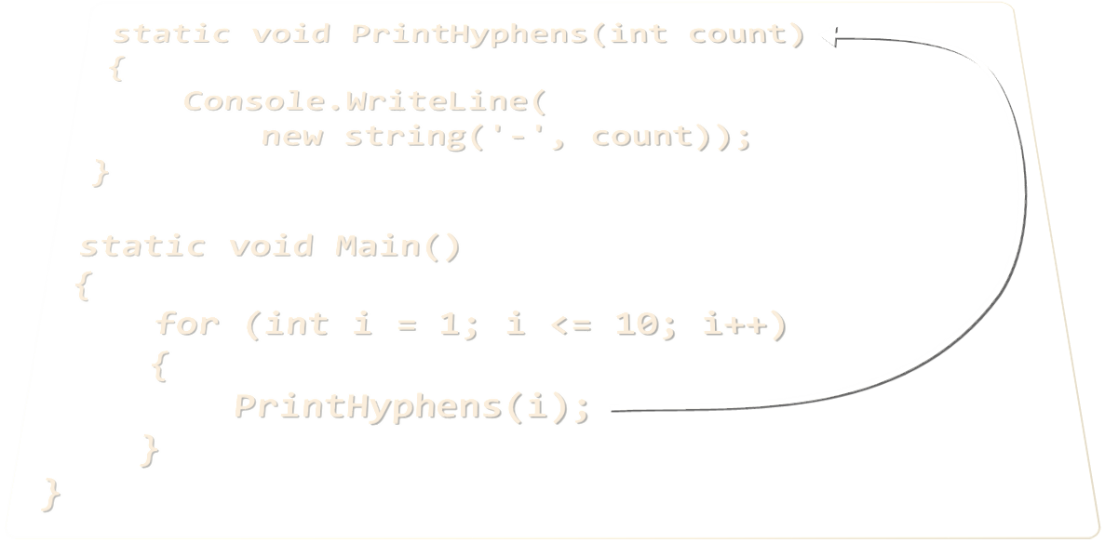
Methods
Named pieces of code

Slide 5
Simple Methods
Methods are named pieces of code that can be invoked later
Sample method definition:
Invoking (calling) the method several times:
Method named PrintHeader
static void PrintHeader()
{
Console.WriteLine("----------");
}
Method body always surrounded by { }
PrintHeader();
PrintHeader();

Slide 6

Why Use Methods?
Better organization of the code
Splits large problems into small pieces
Improves code readability
Improves code understandability
Avoiding repeating code
Improves code maintainability
Code reusability
Using existing methods several times

Slide 7
Declaring Methods
Method Name
Return Type
Parameters
In C#, methods are declared inside a class
Main() is also a method
Declared variables are local
static double GetSquare(double num)
{
return num * num;
}
Body
class Program
{
static void Main(string[] args)
{
}
}

Slide 8
Invoking a Method
Methods can be invoked (called) by their name
Invoking (calling) the method:
static void PrintHeader()
{
Console.WriteLine("----------");
}
Method Declaration
static void Main()
{
PrintHeader();
}
Method Invocation

Slide 9
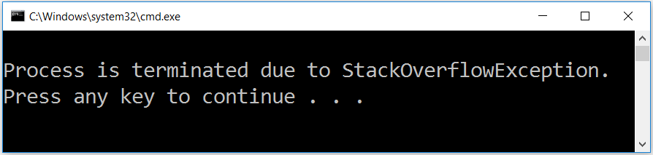
Invoking a Method (2)
A method can be invoked from:
The main method – Main()
Its own body – Recursion
Some other method
static void Main()
{
PrintHeader();
}
static void PrintHeader()
{
PrintHeaderTop();
PrintHeaderBot();
}

Slide 10
Problem: Blank Receipt
Create a method that prints a blank cash receipt:
CASH RECEIPT
------------------------------
Header
Charged to____________________
Received by___________________
Body
------------------------------
© SoftUni
Footer
Check your solution here: https://judge.softuni.bg/Contests/Practice/Index/417#0

Slide 11
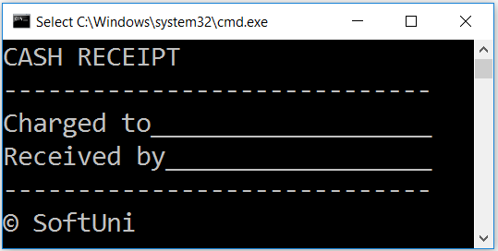
Solution: Blank Receipt
Create three methods printing each section (PrintHeader(), etc.)
Copy the content from the slide
For the copyright sign use the Unicode "\u00A9"
Create a method PrintReceipt() that calls all three methods:
private static void PrintReceipt()
{
PrintHeader();
PrintBody();
PrintFooter();
}
Check your solution here: https://judge.softuni.bg/Contests/Practice/Index/417#0

Slide 12

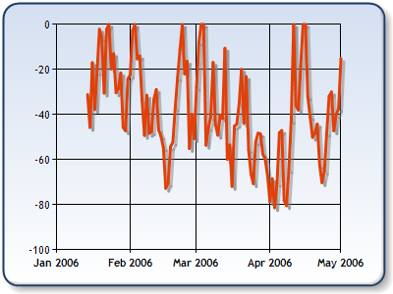
Methods With Parameters
int
long
double
float
decimal

Slide 13
Method Parameters
Method parameters can be of any data type
Declares the use of
int start and int end
static void PrintNumbers(int start, int end)
{
for (int i = start; i <= end; i++)
{
Console.Write("{0} ", i);
}
}
Multiple parameters separated by comma
Call method with concrete values
static void Main()
{
PrintNumbers(5, 10);
}
Passing concrete values when called

Slide 14
Method Parameters (2)
You can pass zero or several parameters
You can pass parameters of different types
Each parameter has name and type
Parameter name
Multiple parameters of different types
Parameter type
static void PrintStudent(string name, int age, double grade)
{
Console.Write("Student: {0}; Age: {1}, Grade: {2}",
name, age, grade);
}

Slide 15
Problem: Sign of Integer Number
Create a method that prints the sign of an integer number n:
2
The number 2 is positive.
-5
The number -5 is negative.
0
The number 0 is zero.
Check your solution here: https://judge.softuni.bg/Contests/Practice/Index/417#1

Slide 16
Solution: Sign of Integer Number
static void PrintSign(int number)
{
if (number > 0)
Console.WriteLine("The number {0} is positive", number);
else if (number < 0)
Console.WriteLine("The number {0} is negative.", number);
else
Console.WriteLine("The number {0} is zero.", number);
}
Check your solution here: https://judge.softuni.bg/Contests/Practice/Index/417#1

Slide 17
Optional Parameters
C# supports optional parameters with default values:
The above method can be called in several ways:
static void PrintNumbers(int start = 0, int end = 100)
{
for (int i = start; i <= end; i++)
Console.Write("{0} ", i);
}
Used as default values.
PrintNumbers(5, 10);
PrintNumbers(15);
PrintNumbers();
PrintNumbers(end: 40, start: 35);
Can be skipped at method invocation.

Slide 18
Problem: Printing Triangle
Create a method for printing triangles as shown below:
1
1 2
1 2 3
1 2 3 4
1 2 3
1 2
1
1
1 2
1 2 3
1 2
1
3
4
Check your solution here: https://judge.softuni.bg/Contests/Practice/Index/417#2

Slide 19
Solution: Printing Triangle
Create a method that prints a single line, consisting of numbers from a given start to a given end:
static void PrintLine(int start, int end)
{
for (int i = start; i <= end; i++)
{
Console.Write(i + " ");
}
Console.WriteLine();
}
Check your solution here: https://judge.softuni.bg/Contests/Practice/Index/417#2

Slide 20
Solution: Printing Triangle (2)
Create a method that prints the first and then the second half of the triangle:
Method with parameter n
static void PrintTriangle(int n)
{
for (int line = 1; line <= n; line++)
PrintLine(1, line);
for (int line = n - 1; line >= 1; line--)
PrintLine(1, line);
}
Check your solution here: https://judge.softuni.bg/Contests/Practice/Index/417#2

Slide 21
Problem: Draw а Filled Square
Draw at the console a filled square of size n like in the example:
--------
-\/\/\/-
-\/\/\/-
--------
----------
-\/\/\/\/-
-\/\/\/\/-
-\/\/\/\/-
----------
4
5
Check your solution here: https://judge.softuni.bg/Contests/Practice/Index/417#3

Slide 22
Solution: Draw a Filled Square
static void PrintHeaderRow(int n)
{
Console.WriteLine(new
string('-', 2 * n));
}
static void PrintMiddleRow(int n)
{
Console.Write('-');
for (int i = 1; i < n; i++)
Console.Write("\\/");
Console.WriteLine('-');
}
Method with parameter n
static void Main() {
int n = // TODO: read n
PrintHeaderRow(n);
for (int i = 0; i < n - 2; i++)
PrintMiddleRow(n);
PrintHeaderRow(n);
}

Slide 23

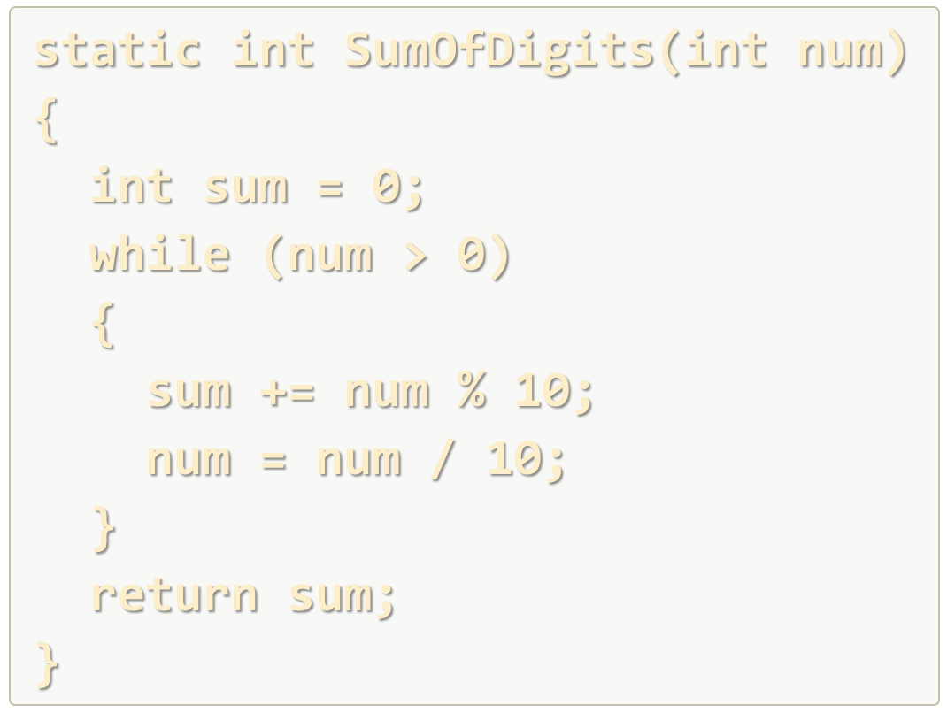
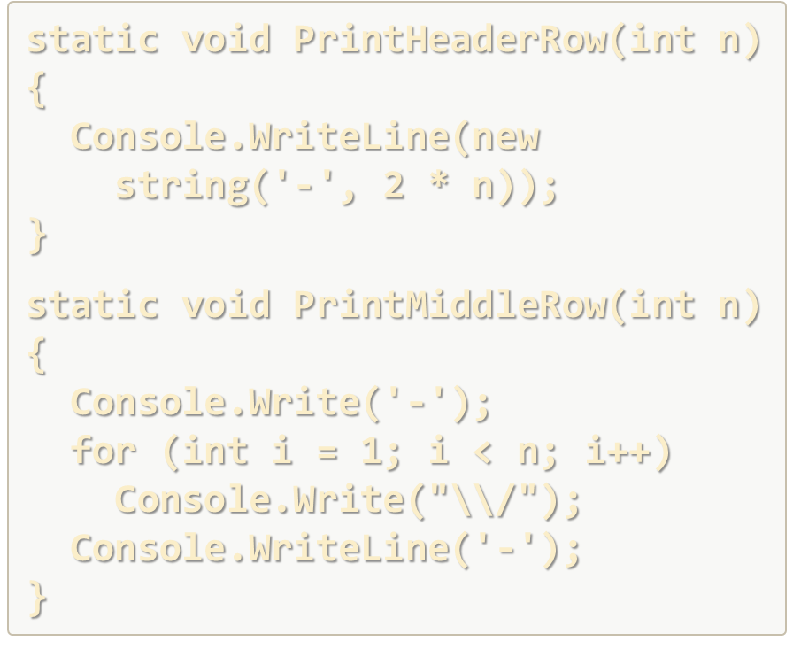
Declaring and Invoking Methods
Live Exercises in Class (Lab)

Slide 24

Returning Values From Methods

Slide 25
Method Return Types
Type void - does not return a value (only executes code)
Other types - return values, based on the return type of the method
static void AddOne(int n)
{
n += 1;
Console.WriteLine(n);
}
No return statement
static int PlusOne(int n)
{
return n + 1;
}
return statement with int value

Slide 26
The Return Statement
Immediately terminates the method's execution
Returns specified value
Void methods can be terminated by just using return
static string ReadFullName()
{
string firstName = Console.ReadLine();
string lastName = Console.ReadLine();
return firstName + " " + lastName;
}
Returns a string
return;

Slide 27
Using the Return Values
Return value can be:
Assigned to a variable:
int max = GetMax(5, 10);
Used in expression:
decimal total = GetPrice() * quantity * 1.20m;
Passed to another method:
int age = int.Parse(Console.ReadLine());

Slide 28
Temperature Conversion – Example
Convert temperature from Fahrenheit to Celsius:
static double FahrenheitToCelsius(double degrees)
{
double celsius = (degrees - 32) * 5 / 9;
return celsius;
}
static void Main()
{
Console.Write("Temperature in Fahrenheit: ");
double t = double.Parse(Console.ReadLine());
t = FahrenheitToCelsius(t);
Console.Write("Temperature in Celsius: {0}", t);
}

Slide 29
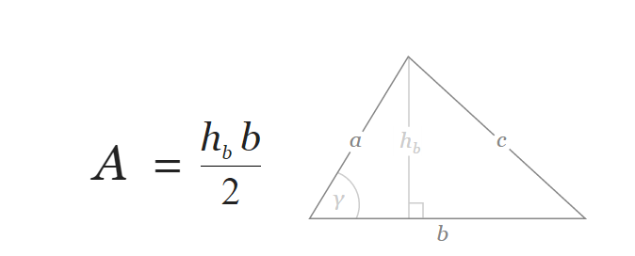
Problem: Calculate Triangle Area
Create a method that calculates and returns the area of a triangle by given width and height
b = 3
h_{b} = 4
A = 6
Check your solution here: https://judge.softuni.bg/Contests/Practice/Index/417#4

Slide 30
Solution: Calculate Triangle Area
Create a method with two double parameters and a double return value:
static double GetTriangleArea(double width, double height)
{
return width * height / 2;
}
static void Main()
{
double width = double.Parse(Console.ReadLine());
double height = double.Parse(Console.ReadLine());
Console.WriteLine(GetTriangleArea(width, height));
}
Check your solution here: https://judge.softuni.bg/Contests/Practice/Index/417#4

Slide 31
Problem: Power Method
Create a method that calculates and returns the value of a number raised to a given power
2⁸
256
3⁴
81
static double RaiseToPower(double number, int power)
{
double result = 1;
for (int i = 0; i < power; i++)
result *= number;
return result;
}
Check your solution here: https://judge.softuni.bg/Contests/Practice/Index/417#5

Slide 32

Overloading Methods

Slide 33
Method Signature
The combination of method's name and parameters is called signature
Signature is used to differentiate between methods with same names
Having methods with same names but different signatures is called Method Overloading
Method's Signature
static void Print(string text)
{
Console.WriteLine(text);
}

Slide 34
Overloading Methods
Using same name for multiple methods with different signatures (method name and parameters)
static void Print(string text)
{
Console.WriteLine(text);
}
static void Print(int number)
{
Console.WriteLine(number);
}
Method's Signature
Method's Signature
Method's Signature
static void Print(string text, int number)
{
Console.WriteLine(text + ' ' + number);
}

Slide 35
Signature and Return Type
Method's return type is not part of its signature
Consider the example:
How would the compiler know which method to call?
static void Print(string text)
{
Console.WriteLine(text);
}
static string Print(string text)
{
return text;
}

Slide 36
Problem: Greater of Two Values
Create a method GetMax() that returns the greater of two values. The values can be of type int, char or string.
int
2
16
16
char
a
z
z
string
aaa
bbb
aaa
Check your solution here: https://judge.softuni.bg/Contests/Practice/Index/417#6

Slide 37
Returning Values and Overloading
Live Exercises in Class (Lab)

Slide 38

Methods – Naming and Best Practices

Slide 39
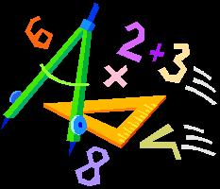


Naming Methods
Methods naming guidelines
Use meaningful method names
Method names should answer the question:
What does this method do?
If you cannot find a good name for a method, think about whether it has a clear intent
FindStudent, LoadReport, Sine
Method1, DoSomething, HandleStuff, SampleMethod, DirtyHack

Slide 40
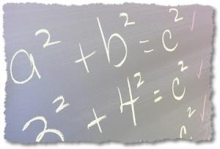
Naming Method Parameters
Method parameters names
Preferred form: [Noun] or [Adjective] + [Noun]
Should be in camelCase
Should be meaningful
Unit of measure should be obvious
firstName, report, speedKmH, usersList, fontSizeInPixels, font
p, p1, p2, populate, LastName, last_name, convertImage

Slide 41
Methods – Best Practices
Each method should perform a single, well-defined task
Method's name should describe that task in a clear and non-ambiguous way
Avoid methods longer than one screen
Split them to several shorter methods
private static void PrintReceipt()
{
PrintHeader();
PrintBody();
PrintFooter();
}
Self documenting and easy to test
Self documenting and easy to test

Slide 42
Code Structure and Code Formatting
Make sure to use correct indentation
Leave a blank line between methods, after loops and after if statements
Always use curly brackets for loops and if statements
Avoid long lines and complex expressions
static void Main()
{
// some code..
// some more code..
}
static void Main()
{
// some code..
// some more code..
}

Slide 43

Summary
Break large programs into simple methods that solve small sub-problems
Methods consist of declaration and body
Methods are invoked by their name
Methods can accept parameters
Parameters take actual values when calling a method
Methods can return a value or nothing (void)

Slide 44









Methods
https://softuni.bg/courses/programming-fundamentals

Slide 45

License
This course (slides, examples, demos, videos, homework, etc.) is licensed under the "Creative Commons Attribution-NonCommercial-ShareAlike 4.0 International" license
Attribution: this work may contain portions from
"Fundamentals of Computer Programming with C#" book by Svetlin Nakov & Co. under CC-BY-SA license
Icons from http://www.flaticon.com/ (credits: Freepik, Madebyoliver)

Slide 46





Trainings @ Software University (SoftUni)
Software University – High-Quality Education, Profession and Job for Software Developers
softuni.bg
Software University Foundation
softuni.org
Software University @ Facebook
facebook.com/SoftwareUniversity
Software University Forums
forum.softuni.bg

